Slide 1

How to use the
EHS Compliance Requirements Guide
(Formerly the Compliance Calendar)

Slide 2

What is the EHS Compliance Requirements Guide?
A comprehensive (we hope!) list of all EHS compliance-related tasks a work unit may have to perform including:
  Inspections of equipment, workplaces, tie-off points, etc.
  Trainings
  Time-of-use requirements
  Permits, licenses, inventories, and other required documentation
  Equipment calibration and testing
  Recordkeeping related to safety tasks

Slide 3
2022 EHS Compliance Requirements Guide
  The guide has been revised with comprehensive EHS Program approach and defined as a compliance monitoring tool for customers university-wide.
  The Guide:
    Describes what is required
    Includes frequency
    Dovetails with the EHS Records Retention Plan
  Is tailored towards different work units and customizable
  Can be used to populate work order and task management systems, tracking sheets, calendars, etc. and to help you budget for safety needs

Slide 4
What has changed?
Updated to include all current programs and guidelines
Meshed with Records Retention Plan
Includes programs in Office of the Physical Plant (OPP) Safety that are not currently in EHS listing
Cross-references to related programs and requirements housed in Office of the Senior Vice President for Research (OVPR) and Ethics & Compliance (E&C)
NOTE: Additional 150+ detailed line items have been added to the current version compared to the 2017 version.

Slide 5
Updates and Changes cont.
  Predicted safety budget costs, such as:
    Annual 3rd Party Rooftop Active Fall Protection Inspections: ~$1,000 - $1,500 per building
    Fall Protection Equipment: Harness replacements every 5 years - $150-$500 each
    Chemical Hazardous Waste: Currently budgeted and paid for by EHS and OPP capital projects
    Biosafety Cabinets: Annual inspections by 3rd party inspections - $500-$1,000 each
    Crane and Hoist: Annual inspections by 3rd party inspections - $1,000 each

Slide 6

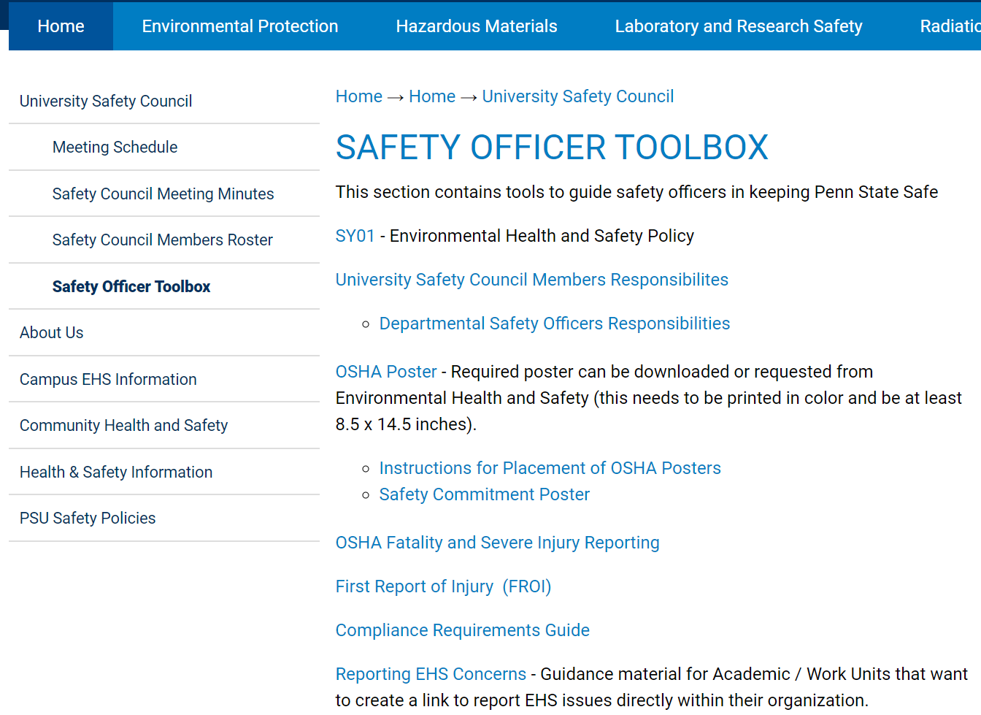
Where to find the Compliance Requirements Guide (CRG)
There are two options to access the CRG including the following:
1. EHS Home page: Quick Links
2. Safety Officer Toolbox
www.ehs.psu.edu > Home tab > University Safety Council > Safety Officer Toolbox
www.ehs.psu.edu > Quick Links > Compliance Requirements Guide
Note: An instruction sheet is also available on the ‘Read Me’ tab in the CRG.

Slide 7
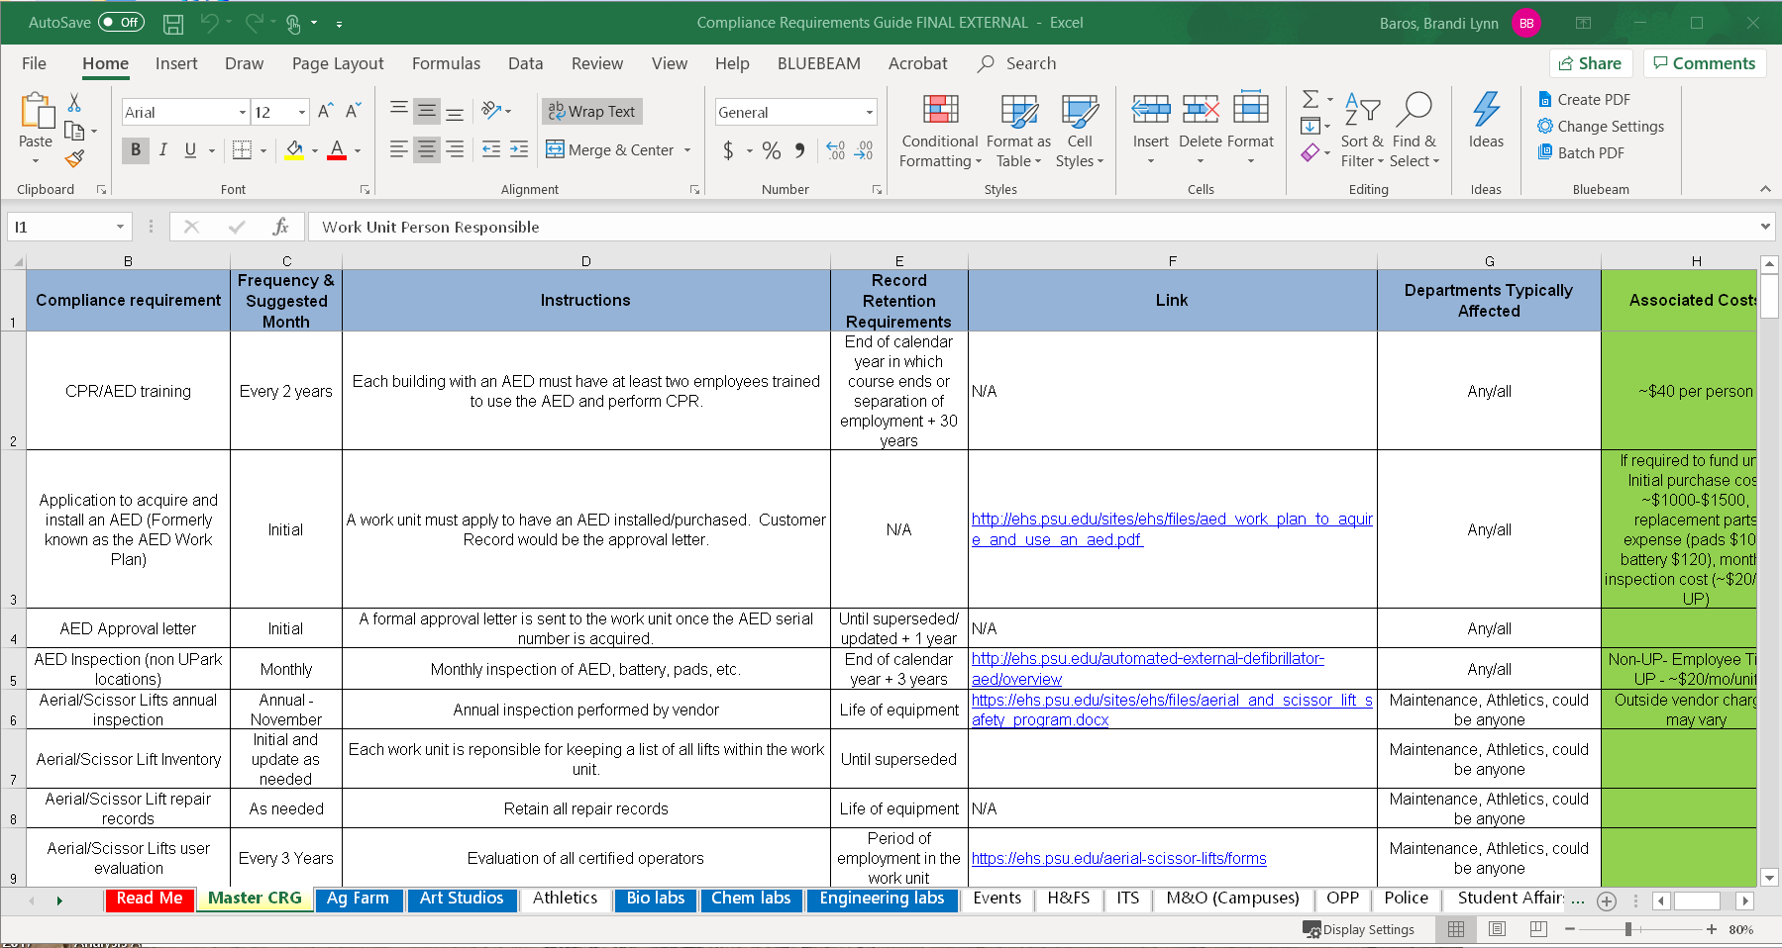
How to use the CRG
When you download the file, it will most likely open to the ‘Master CRG” sheet of the file (the name in the tab is highlighted in yellow).
If you want to look at a different sheet (such as the instructions on the “Read Me” sheet, or a sheet that is more tailored to your work unit, click the tab you want in the row this arrow points to:
The “Master CRG” sheet is a comprehensive listing of ALL current EHS compliance requirements.
Note: Many of these may not apply to your work group, so there are sheets tailored to different work groups.
If you think you might be missing a requirement, look back in the “Master CRG” sheet.

Slide 8
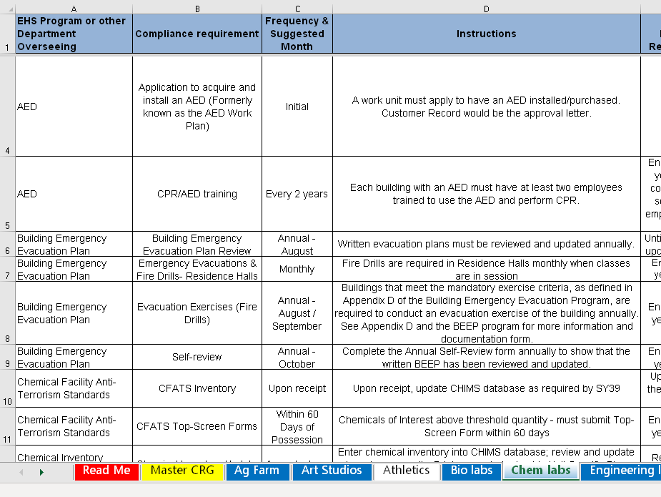
Tailored work-group sheets
The sheets that have been tailored for specific types of work groups have the requirements list reduced to the items most likely to affect those groups.
For example, in the “Chem labs” page created for chemistry lab personnel, the listings for topics such as aerial lifts and scaffolds (which are not likely to be in a chemistry lab) have been removed. The list may still include other things that do not necessarily apply to your lab.

Slide 9

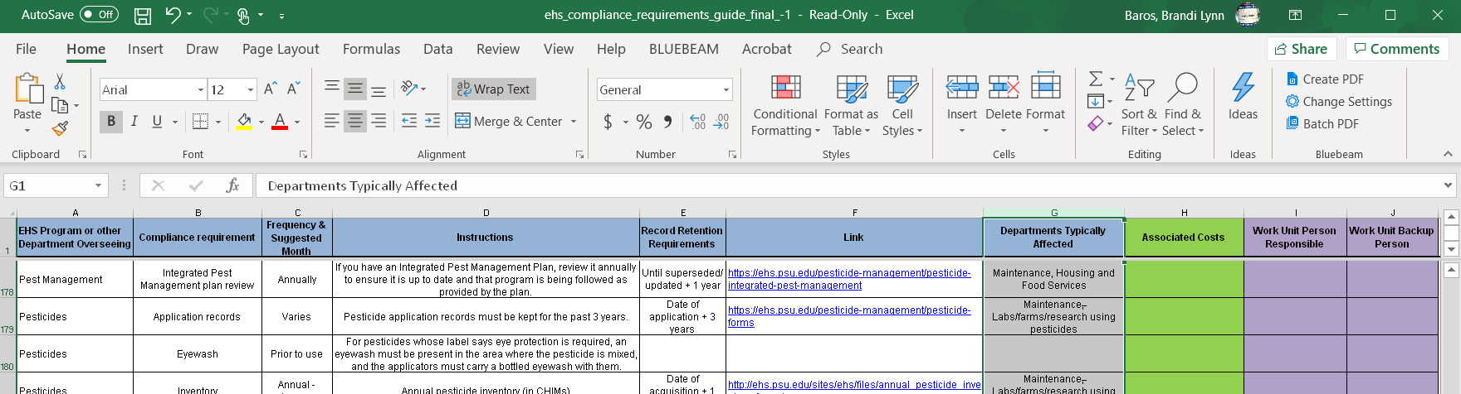
Deleting unwanted columns
You can also delete columns you don’t need. For example, as you’re further along with customizing your own sheet, you might not care about the “Departments Typically Affected” column.
Click the gray bar above Row 1 (in this case, it’s the top of Column G). The entire column should change color slightly.
Then right-click to get a drop-down menu. Choose “Delete”, and this will delete the entire row.
Remember, if you make a mistake, you can just hit “undo”.
Or, if you want to start over, you can download a fresh version
of the CRG at https://ehs.psu.edu/sites/ehs/files/ehs_compliance_requirements_guide_final_.xlsx

Slide 10
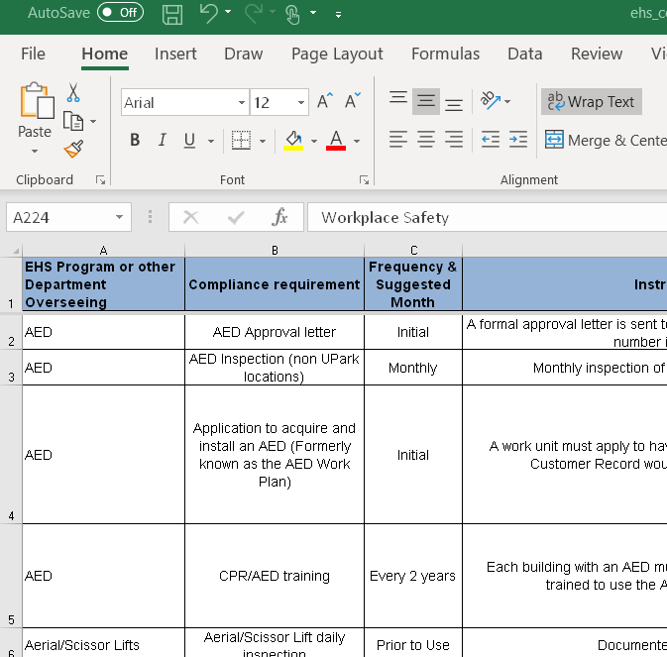
Sorting the sheet
You can sort your sheet by different column headings. For example, you can sort by Frequency to see what has to be done weekly, monthly, annually, etc. grouped together.
1. Click the square in the upper left to select the entire sheet.
Directions continue on next slide

Slide 11
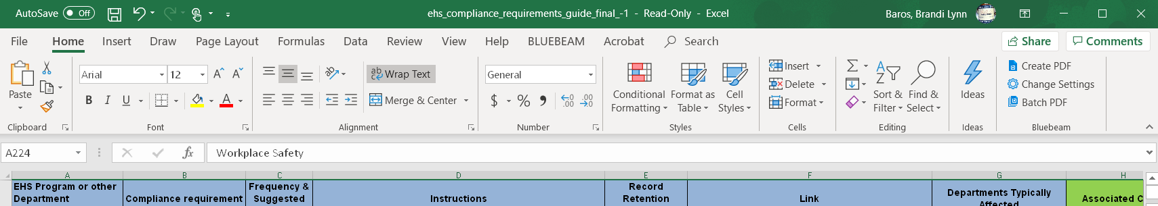
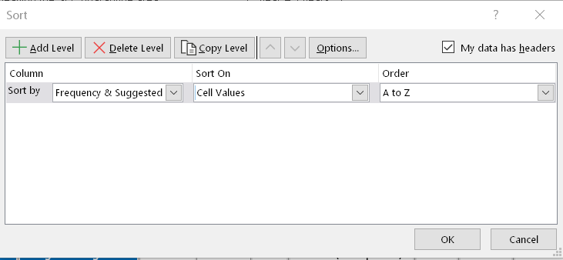
Sorting, continued
2. Under the “Home” menu, click “Sort & Filter”. This will give you a drop-down menu, from which you should select “Custom Filter”.
This will give you a new window titled “Sort”.
Check the box that says “My data has headers”.
Click the drop-down arrow to choose the column you want to sort by. You can also choose for them to be sorted A to Z, or Z to A (which would put weekly before annual).
Click “OK”.

Slide 12

Conditional formatting
Conditional formatting is a way to make specific information you want stand out.
For example, you can make every training requirement come up in a highlighted color so you can easily check to see if your team is missing anything.
To do this, from the “Home” menu, click the little down-arrow next to “Conditional Formatting”
This will bring up a drop-down menu. From it, select “Highlight Cells Rules”. This will bring up another drop-down menu, and from it, select “Text that contains…”

Slide 13
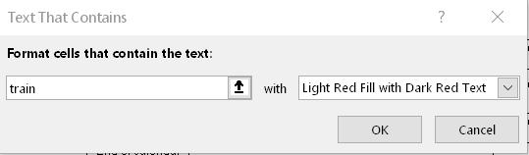
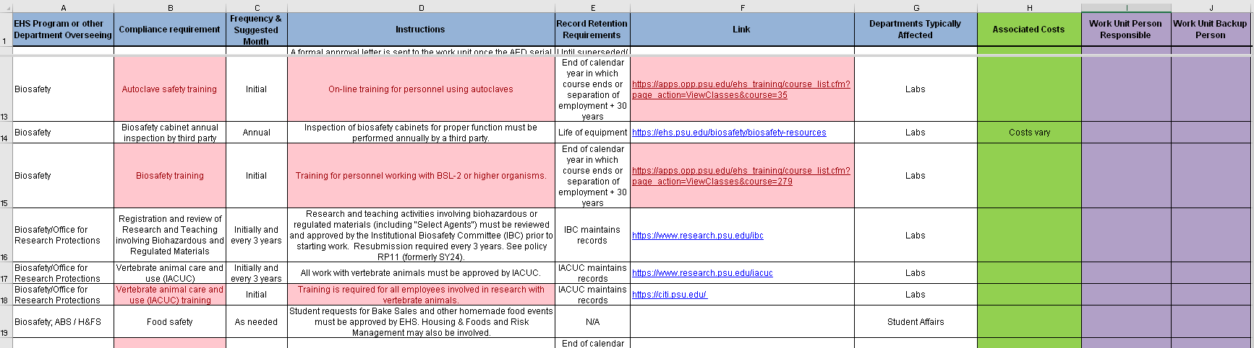
Conditional Formatting continued
In the dialogue box that comes up, type in “train” (or “training”, but “train” will also find the words “trained”, “trainer”, etc.
If you want a different color combination, select that in the second box.
Then click “OK”.
The result will look something like the image below.

Slide 14
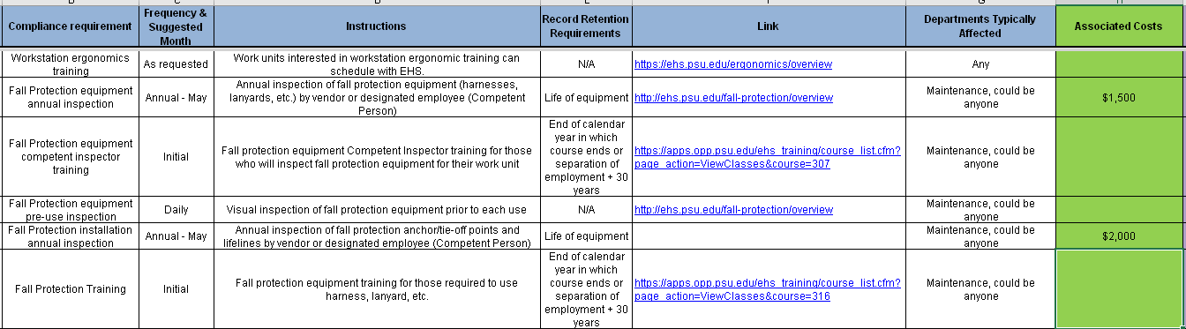
Estimate your safety budget
You can use the green “Associated Costs” column to fill in the items that you know your department has to pay for. We’ve given you some ballpark ideas here, but you can delete those and fill in your known costs and add them up.
For example, this Maintenance department may need to replace their three harnesses this year, and so they’re budgeting $500 each for $1500 total under “inspection”, and the $2000 they know it costs to have all of their rooftop tie-offs inspected.
At the bottom of the column, you can add up your total using the method shown on the next slide.

Slide 15
Totaling your estimated safety budget
For this to work properly, all of the entries in the column you want to add up have to be only numbers – no text, no punctuation.
Scroll down to the row below the last entry. In the cell below the bottom of the green column - Type the following: =SUM(
Use your mouse to highlight the cells you want to add up. Remember not to include the column header! This will auto-populate the cell and it will read something like: =SUM(H2:H243
The numbers may vary depending on how many lines you’re totaling. Add the other parenthesis so it looks like this: =SUM(H2:H243)
Hit Enter. It should calculate the total of the numbers you selected in that column. If it gives you an error, check to make sure that everything you selected is only a number (no letters), and that you put the formula in as above, with no spaces and with the equals sign, parentheses, and colon where they should be.

Slide 16
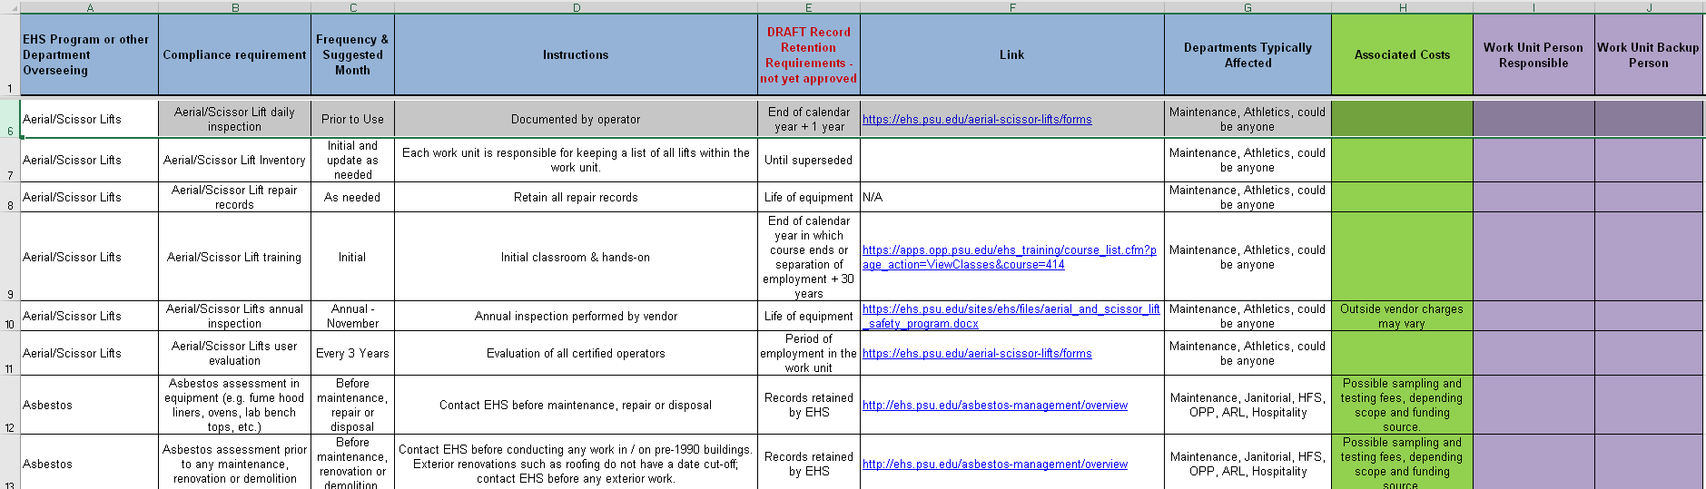
Records Retention
The CRG also provides information on how long records should be retained. NOTE that we are still awaiting final approval on this records retention plan, so PLEASE do not throw anything out yet!
Column E shows this information. Some explanations of exactly what this means are on the next slide.

Slide 17
Records retention continued
End of calendar year + 1 year (or any other number of years): At the end of 2022, you will keep all 2022 records for that item plus all records from the previous year (or 3 years or whatever is specified). Once the EHS Records Retention plan is approved, you can discard the older records.
End of calendar year…. OR separation of employment + 30 years: Whichever is longer applies. This usually means we keep that record for 30 years beyond when the employee retires/leaves.
Until superseded or Retain current version: When you update this document, keep the new version and discard the old one
Until superseded + 1 year (or any other number of years): Keep the most recent and the last one before that. Once the EHS Records Retention plan is approved, you can discard the older records.
Life of equipment: Keep these records as long as you have that equipment, and transfer them with the equipment if you transfer the equipment to someone else.
NOTE that we are still awaiting final approval on this records retention plan, so PLEASE do not throw anything out yet!

Slide 18
Record retention continued
Period of employment in the work unit: Keep these records until the employee retires or moves elsewhere. If the employee moves within PSU, those records can be transferred to the new supervisor.
Retain at campus for 3 years, then archive with EHS: Keep these documents for 3 years, and at the end of that calendar year, hand them to your Campus EHS Representative and we’ll archive them.
EHS maintains record: If you have any of these, hand them over to your EHS contact.
N/A: No recordkeeping applies to this item.
NOTE that we are still awaiting final approval on this records retention plan, so PLEASE do not throw anything out yet!
As always, if you have any questions, please ask us! We’re happy to help.

Slide 19
Excel help
There are several sources of help if you want to learn more about how to make Excel work for you, including:
Tutorials at linkedinlearning.psu.edu
Courses at lrn.psu.edu (look under Technology > Office 365)
Microsoft support at support.office.com

Slide 20
Further questions?
Contact EHS:
Email psuehs@psu.edu
Call 814-865-6391
Talk to your Safety Officer
or Campus EHS Representative

